Slide 1
Disk Golf Companion
The Fellowship of Brandons
Stephen Beckstrand - Lead Back End Developer
Brandon Hicken - Front End Developer
Vinny Smith - Back End Developer/Diagram Designer
Brandon Stone - Web Designer/Documentor

Slide 2
The Building Blocks
The Disk Golf Companion was implemented via a Nuxt.js frontend and a Django backend. Through the use of the Django database, the information was serialized into data that the javascript frontend could interpret and display to the screen. Data stored includes:
Authentication of Users
What Groups are assigned
Tournaments data
What Users are in what Tournaments
User resources
Logos, buying power, drink availability, etc.

Slide 3
Front/Back end Communication
Our backend talks to the front end, and vice-versa, thanks to the development our API. The API contains info models, paths, migrations and serializers that interpret the inbound javascript and python, and kick out data recognizable to the other.
How do the uses of javascript and python communicate?

Slide 4
Default Users
With the current deployment of the Disk Golf Companion, some default data is supplied before a single user is created. The built-in users are the following:
User: manager Pass: manager ID: 1
User: drinkster Pass: drinkster ID: 2
User: sponsor Pass: sponsor ID: 3
Each of the default users is assigned a single group that exhibits some of the core functionality the Companion provides. The manager is a member of the Manager group, the drinkster is a member of the Drink Meister group and he sponsor is a member of the Sponsor group. Each group holds all permissions assigned to that station.

Slide 5
Player Group
The Player group is the default Group all Users are assigned upon sign-up.
Players can register for tournaments, order drinks, and load up their finances, but they have the most limited permissions of all groups. As the default, no user can be “just” a Drink Meister, but will be considered a Player as well. As such, every Group will have the prerequisite permissions that the Player Group exhibits.
Currently there is no method to remove a User’s role as a Player, thereby revoking basic functionality of the Disk Golf Companion.

Slide 6
Other Important Groups
Managers
SuperUser
Has all Group permissions.
Create and participate in Tournaments.
Assign groups to other Users, including Manager group.
Deactivate tournaments to a forced close.
Drink Meisters
Creates new drink options for Users.
Participates in Tournaments.
Fulfills drink orders inputted by all other Users.
Sponsors
Imports Logos that will be displayed on selected tournaments.
Participates in Tournaments.
Order drinks.

Slide 7
Default Drinks
There are 5 default drinks that the Drink Meister can edit or remove at their pleasure. Mango/Orange Screwdriver, Rum n’ Coke, Sprite, Coca-Cola, and Mountain Dew are readily available selections for any User. These drinks are added for the training and convenience of users new to the Companion app.
For quick integration, the primary user may sign into the default “drinkster” User and test the dummy drink data before implementing their own options that they’ve worked out with management and sponsors.

Slide 8
To Drink or Not to Drink…
Drink models are stored in the backend with a title, description, type, and price. Users may invoke an “order” method which will check the User balance, then charge the attached price of the drink to their balance. If the balance is insufficient for the drink order, the user is notified via pop-up message and the order is ignored.
Drink orders are submitted to the Drink Meister. The drinkster can fill and deliver the order, and mark it as complete to finish the transaction. This streamlines the ordering process, and eliminates the need to hand out physical menus to all tournament participants.

Slide 9
Authentication
Authentication for the Disk Gold Companion is simple. User data inputted from the frontend \signup page is verified then stored within the Django database. Verification includes checking the existing database for any User with the same username. If the username is already taken, the New User receives an error and can input a new username.
As a user is authenticated and brought to the landing page, they will have limited access to the rest of the pages based upon the Groups they’re assigned. The default group of “Player” is assigned, so the New User may order drinks, sign up for tournaments, and exercise other core functions of the companion.

Slide 10
Tournaments: What to Expect
All Users may sign up for any Tournament listed within the database. Upon tournament “sign up”, the backend will validate whether the user is available at the tournament date.
After sign up, the tournament will now be conveniently displayed on the User Dashboard, where the details can be easily accessed and viewed. This Dashboard view now displays all active and inactive tournaments, where scores can be submitted or displayed.
Manager is the only Group with the functionality to create a new Tournament. They’re also allowed to see all other Users that are currently enrolled in the tournament as well. Upon tournament conclusion, the Companion assists Users by piecing together a leaderboard that reviews the scores, so the manager may assign awards according to their own specifications.

Slide 11
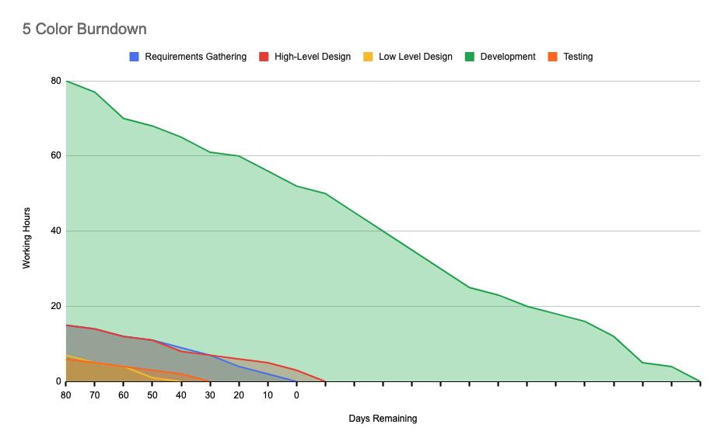
Burndown
Per Task Outline and Burndown are defined in Google Sheets

Slide 12
Resources
Writing your first Django app, part 1 | Django documentation | Django. (n.d.). Docs.djangoproject.com. https://docs.djangoproject.com/en/3.2/intro/tutorial01/
Django documentation | Django documentation | Django. (n.d.). Docs.djangoproject.com. https://docs.djangoproject.com/en/3.2/
alexchopin. (n.d.). Nuxt.js - The Intuitive Vue Framework. NuxtJS. https://nuxtjs.org/
Introduction — Vue.js. (2019). Vuejs.org. https://vuejs.org/v2/guide/
‌Components. (n.d.). BootstrapVue. Retrieved December 5, 2021, from https://bootstrap-vue.org/docs/components

Slide 13
Questions?

